Slide 1
HTTP Protocol
Hyper Text Transfer Protocol
Notes:
10.10.19.155

Slide 2
HTTP Usage
HTTP is the protocol that supports communication between web browsers and web servers.
A “Web Server” is a HTTP server
Most clients/servers today speak version 1.1, but 1.0 is also in use.
Notes:
The primary function of a web server is to deliver web pages on the request to clients using the Hypertext Transfer Protocol (HTTP). This means delivery of HTML documents and any additional content that may be included by a document, such as images, style sheets and scripts.
El protocol hwa elly version 1.1?? Ah el protocol elly bst5dmo ana w el server (el browser)(el program elly bst5dmo)

Slide 3
From the RFC (Request for Comments)
“HTTP is an application-level protocol with the lightness and speed necessary for distributed, hypermedia information systems.”
Notes:
El 2wl by request ll text w b3den request tany ll swr w b3den ll 2lwan 3shan kda byb2a sare3

Slide 4
Transport Independence
The RFC states that the HTTP protocol generally takes place over a TCP connection, but the protocol itself is not dependent on a specific transport layer.
Notes:
Elly 3mloh kano 3la 2sas eno ysht3’l 3la el TCP, bs 3mloh general 3shan ysht3’l 3la 2y 7aga

Slide 5
Request - Response
HTTP has a simple structure:
Client sends a request.
Server returns a reply.
HTTP can support multiple request reply exchanges over a single TCP connection, as opposed to opening a new connection for every single request/response pair.
Notes:
El browser hwa elly by5tar ysht3’ b 2nhy model

Slide 6
Well Known Address
The “well known” TCP port for HTTP servers is port 80.
Other ports can be used as well...
Notes:
HTTP lw m7ddlhosh port b2idy hwa by5tar 80 (da elly bn3mlo)

Slide 7
HTTP Versions
The original version now goes by the name “HTTP Version 0.9”
HTTP 0.9 was used for many years.
Starting with HTTP 1.0 the version number is part of every request.
tells the server what version the client can talk (what options are supported, etc).

Slide 8
HTTP Request
Lines of text (ASCII).
Lines end with CRLF “\r\n”
First line is called “Request-Line”
Request -Line
Header Lines
Blank line
Content
Notes:
Acronym for the American Standard Code for Information Interchange. Pronounced ask-ee, ASCII is a code for representing English characters as numbers, with each letter assigned a number from 0 to 127. For example, the ASCII code for uppercase M is 77.

Slide 9
Request Line
Method URI HTTP-Version\r\n
The request line contains 3 tokens (words).
Space characters “ “ separate the tokens.
Newline (\n) seems to work by itself (but the protocol requires CRLF)
Method Types:
Get
Post
Head
Request -Line
Header Lines
Blank line
Content
Notes:
URI : relative path?? Lazem? L2 lw m7ttsh host f el content yb2a lazem tkol absolute

Slide 10
Methods
GET: retrieve information identified by the URI.
HEAD: retrieve meta-information about the URI.
POST: send information to a URI and retrieve result.
Notes:
HEAD?? Crowler for last modified pages The metainformation contained in the HTTP headers in response to a HEAD request should be identical to the information sent in response to a GET request. This allows a client to obtain meta-information about a resource without actually transferring the resource itself. POST: The request URI is not a resource to retrieve; it's usually a program to handle the data you're sending.
The HTTP response is normally program output, not a static file.

Slide 11
Typical Usages
GET used to retrieve an HTML document.
HEAD used to find out if a document has changed.
POST used to submit a form.

Slide 12
URI: Universal Resource Identifier
URIs defined in RFC 2396.
Absolute URI:
scheme://hostname[:port]/path
Example:
http://www.cs.rpi.edu:80/blah/foo
Relative URI:
/path
Example:
/blah/foo
Notes:
El relative URI bnst5dmha lw 27na f nfs el page bs 3yzen nro7 directory tany bs? Walla leha 2st5dmat tanya? yes
El port da optional?yes
http://www.webdevelopersnotes.com/design/relative_and_absolute_urls.php3

Slide 13
Difference between URI and URL
A Universal Resource Locator (URL) is more involved with the location of the resource.
Universal Resource Indicator (URI) is an indicator. It is more general because it is also involved with how you access it (http, ftp, irc, so on).
URI:
irc://www.allnetworks.com
ldap://fcis.edu/cn=networks
URL is just a location of a resource, which is more applicable to http and ftp.
Notes:
2 ezay more general?? El URL msh lazem yb2a feh el protocol lkn el URI lazem yb2a feh protocol
Elly by7dd how to access it el URL? Bs el URI kaman by7dd hwa http walla ftp ….?

Slide 14
HTTP Version Number
“HTTP/1.0” or “HTTP/1.1”
HTTP 0.9 did not include a version number in a request line.
If a server gets a request line with no HTTP version number, it assumes 0.9.

Slide 15
Header Lines
Each header line contains an attribute name followed by a “:” followed by a space and the attribute value.
Example:
Accept: text/html
Host: www.rpi.edu
User-Agent: Mozilla/4.0
Request -Line
Header Lines
Blank line
Content
Notes:
User Agent: your browser is not supported(lw el user agent firefox 2olo … w lw chrome 2b3tha b el tari2a de…)
Fe web pages btft7 3la browser mo3yan w el browser tany l2 ... 7sb sa7eb el web page de
Accept: accepted sources… leh? Kol browser leh accept resources mo3yna 7sb elly ana b7ddhalo
If no Accept: field is present, then it is assumed that text/plain and text/html are accepted.

Slide 16
Headers
Request Headers provide information to the server about the client
what kind of client
what kind of content will be accepted
who is making the request
There can be no header lines at all.(HTTP 1.0)
HTTP 1.1 requires a Host: header
Each header ends with a CRLF ( \r\n )
Notes:
who is making the request???mail address of the user making the request
Ezay ver 1.0 msh feh host? Omal ezay by3rf eih el website? Mn el URI elly f el request line

Slide 17
Blank Line
The end of the header section is marked with a blank line, just CRLF.
Request -Line
Header Lines
Blank line
Content

Slide 18
Content
Content is empty when the method is Get or Head.
Content only takes values with Post method.
There is no format for the data (just raw bytes).
Request -Line
Header Lines
Blank line
Content
Notes:
ASCII bardo? 7sb el content type ascii yb2a text bs

Slide 19
Post
A POST request must include a Content-Length line in the headers:
Example: Content-length: 267
POST /~hollingd/changegrade.cgi HTTP/1.1
Accept: */*
Host: www.cs.rpi.edu
User-Agent: SecretAgent V2.3
Content-Length : 35
Referer: http://monte.cs.rpi.edu/blah
Blank line
stuid=6660182722&item=test1&grade=99
Notes:
Host?? El site elly 3yza 2d5ol 3lih
Referer?? El site elly mno ro7t ll host
Password use post get 3shan msh yzhar ll user f el URL??? yes

Slide 20
Get
The Content is empty, but the blank line is kept.
GET /~hollingd/testanswers.html HTTP/1.1
Accept: */*
Host: www.cs.rpi.edu
User-Agent: Internet Explorer
From: cheater@cheaters.org
Referer: http://foo.com/
Blank line
Notes:
From (email address of requester; only used by Web spiders and other custom clients, not by browsers)

Slide 21
HTTP Response
ASCII Status Line
Headers Section
Content can be anything (not just text)
typically an HTML document or some kind of image.
Status-Line
Header Lines
Blank line
Content
Notes:
2wl 2 lines byb2a ASCII bs el content ana w 7sb el content elly bb3to image walla text…

Slide 22
Response Status Line
HTTP-Version Status-Code Message
Status Code is 3 digit number (for computers)
Message is text (for humans)
Status-Line
Header Lines
Blank line
Content

Slide 23
Status Codes
1xx Informational
2xx Success
3xx Redirection
4xx Client Error
5xx Server Error
Notes:
1- gab el page w b3t info
4- enta b3t 7aga 3’lt
5- ana elly 3ndy moshkla

Slide 24
Example Status Lines
HTTP/1.0 200 OK
HTTP/1.0 301 Moved Permanently
HTTP/1.0 400 Bad Request
HTTP/1.0 500 Internal Server Error
Notes:
El messages de btzhrly fen k user? Msh bshofha momken tfed el programmers

Slide 25
Response Headers
Provide the client with information about the returned entity
what kind of document
how big the document is
how the document is encoded
when the document was last modified
Response headers end with blank line
Status-Line
Header Lines
Blank line
Content
Notes:
Encoded 3shan el browser y3rf el lang w y load el page 3la 2ssha

Slide 26
Response Header Examples
Date: Wed, 30 Jan 2002 12:48:17 EST
Server: Apache/1.17
Content-Type: text/html
Content-Length: 1756
Content-Encoding: gzip
Notes:
Gzip: by3ml ll page compress 2bl ma yb3tha f ana lazem 23mlha depress

Slide 27
Content
Content can be anything (sequence of raw bytes).
Content-Length header is required for any response that includes content.
Content-Type header also required.
Status-Line
Header Lines
Blank line
Content

Slide 28
Single Request/Reply
The client sends a complete request.
The server sends back the entire reply.
The server closes it’s socket.
If the client needs another document it must open a new connection.
This was the default for HTTP 1.0

Slide 29
Persistent Connections
HTTP 1.1 supports persistent connections (this is the default).
Multiple requests can be handled over a single TCP connection.
The “Connection:” request header is used to exchange information about persistence (HTTP/1.1)
1.0 Clients used a “Keep-alive:” request header
Notes:
Connection: keep-alive, Close, and Upgrade

Slide 30
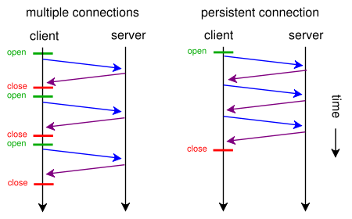

Slide 31
Hands on

Slide 32
Browser Requests and Responses
Start google Chrome.
Press F12 for developers tools.
Browse to www.facebook.com
Watch as the requests the browser is sending to facebook server are flowing in the lower window.
Select the first request and inspect the request and response headers.

Slide 33
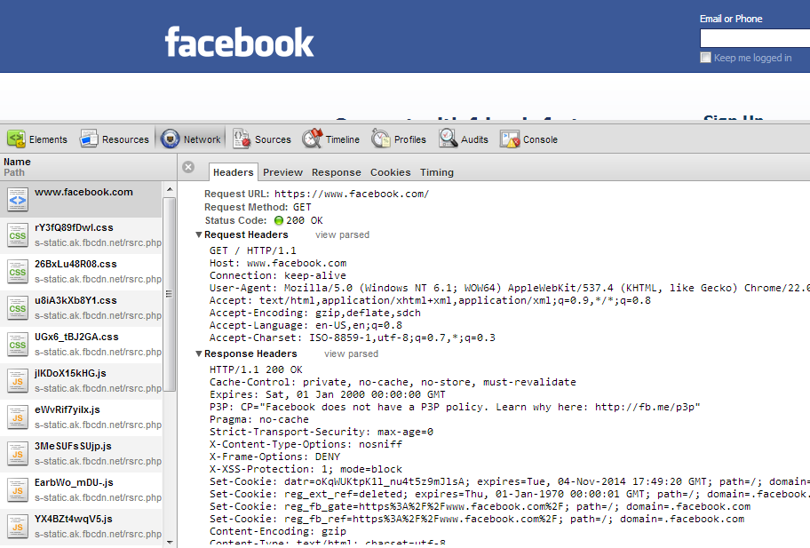

Slide 34
HTTP Client
Let’s create something like a browser.
Multithreaded.
Create a console application “HTTPClient”.
Add HTTPRequest Class.

Slide 35
In program.cs
static void Main(string[] args)
{
string[] websites = new string[]
{ "www.google.com",
"www.facebook.com",
"www.yahoo.com" };
foreach (string website in websites)
{
Thread thread = new Thread(new ParameterizedThreadStart(HTTPRequest.HandleRequest));
thread.Start(website);
}
//To keep the app alive until all threads have finished.
Console.ReadLine();
}
Notes:
Readline: 3shan may2flsh el app 2bl m el threads tkon 5lst

Slide 36
HTTPRequest (1)
public static void HandleRequest(object obj)
{
string website = (string)obj;
IPAddress[] addresses;
try
{
//Gets list of IP addresses bound to that domain.
addresses = Dns.GetHostAddresses(website);
if (addresses.Length == 0)
{
Console.WriteLine("Error: {0}", website);
return;
}
}
catch(Exception ex)
{
Console.WriteLine(ex.Message);
return;
}

Slide 37
HTTPRequest (2)
IPAddress host = addresses[0];
int hostPort = 80;
IPEndPoint hostep = new IPEndPoint(host, hostPort);
Socket socket = new Socket(AddressFamily.InterNetwork, SocketType.Stream, ProtocolType.Tcp);
socket.Connect(hostep);

Slide 38
HTTPRequest (3)
string request = "GET / HTTP/1.1\r\n" +
"Host: " + website + "\r\n" +
"User-Agent: Chrome/22.0.1229.94\r\n"
+ "\r\n";
socket.Send(Encoding.ASCII.GetBytes(request));
byte[] dataReceived = new byte[1024 * 1024];
int len = socket.Receive(dataReceived);
string page = Encoding.ASCII.GetString(dataReceived, 0, len);
socket.Close();
Notes:
Hna by7wl l bytes walla ASCII??? 2y 7aga momken tt7wl l bytes bs el 7rof bs hya elly btt7wl l ASCII

Slide 39
HTTPRequest (4)
StreamWriter writer = new StreamWriter(string.Format("{0}.html", website));
writer.WriteLine(page);
writer.Close();
Console.WriteLine("Finished: {0}", website);
}

Slide 40
Output HTTP Responses
Open bin/Debug folder to find the saved HTTP responses.
Facebook response:
Google response:
Because google redirects to google.com.eg
Yahoo response:
Because yahoo redirects to maktoob.yahoo.com
HTTP/1.1 200 OK
HTTP/1.1 302 Found
Location: http://www.google.com.eg/
HTTP/1.1 302 Found
Location: http://maktoob.yahoo.com/?p=us

Slide 41
References
http://www.cs.rpi.edu/~hollingd/netprog/notes/http/http.pdf

